Slide 1
Machine Learning for data science and business intelligence – 8IAR403
By Kévin Bouchard Ph.D.
Professor in artificial intelligence & machine learning
Laboratoire d'Intelligence Ambiante pour la reconnaissance d'activités (LIARA)
Université du Québec à Chicoutimi
www.Kevin-Bouchard.ca

Slide 2
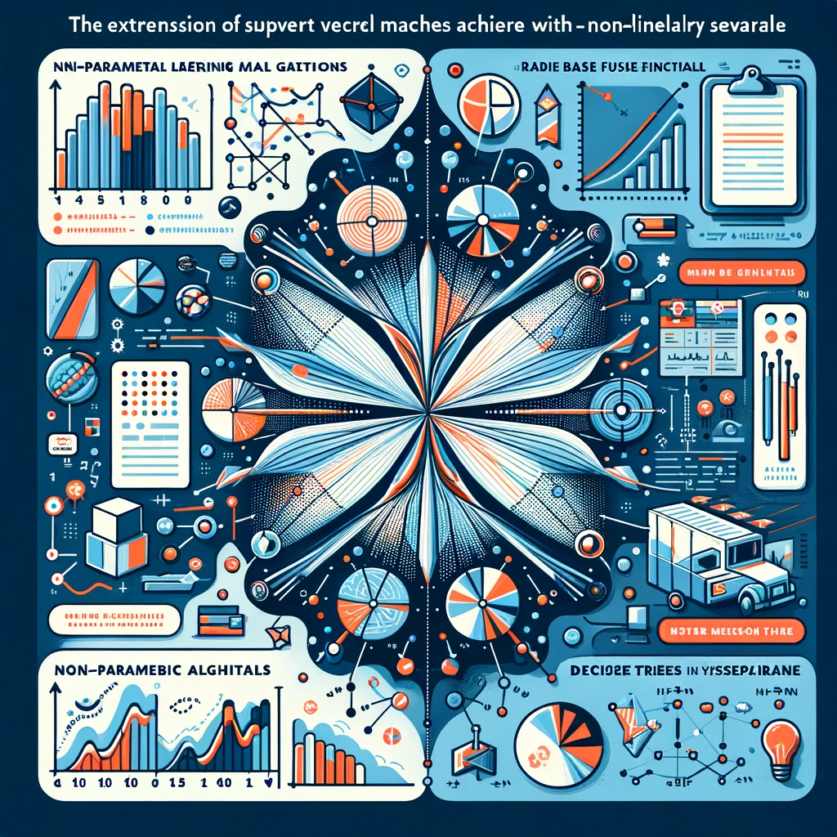
Summary of lesson #8
You will learn about:
Non-parametric ML including
K-Nearest Neighbor
Naïve Bayes and the basic idea behind the Bayes rules
Decision Trees and how to ensure they are not falling into overfitting

Slide 3

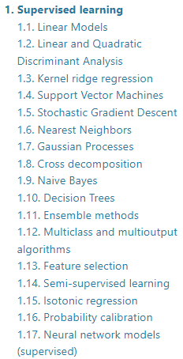
Parametric or Not?
Parametric
Non-parametric
Simple Fast learning Few data required
Flexible Very expressive + performance
Constrained to a predefined form For simple problems
Overfitting Slower More data required
Advantages
Inconvenients
Notes:
Our models were parametric, although with the Kernel trick they can in fact become non-parametric (RBF)
Basically, parametric means the model doesn’t change according to the data
So this is true, but not for deep learning (explain briefly)

Slide 4
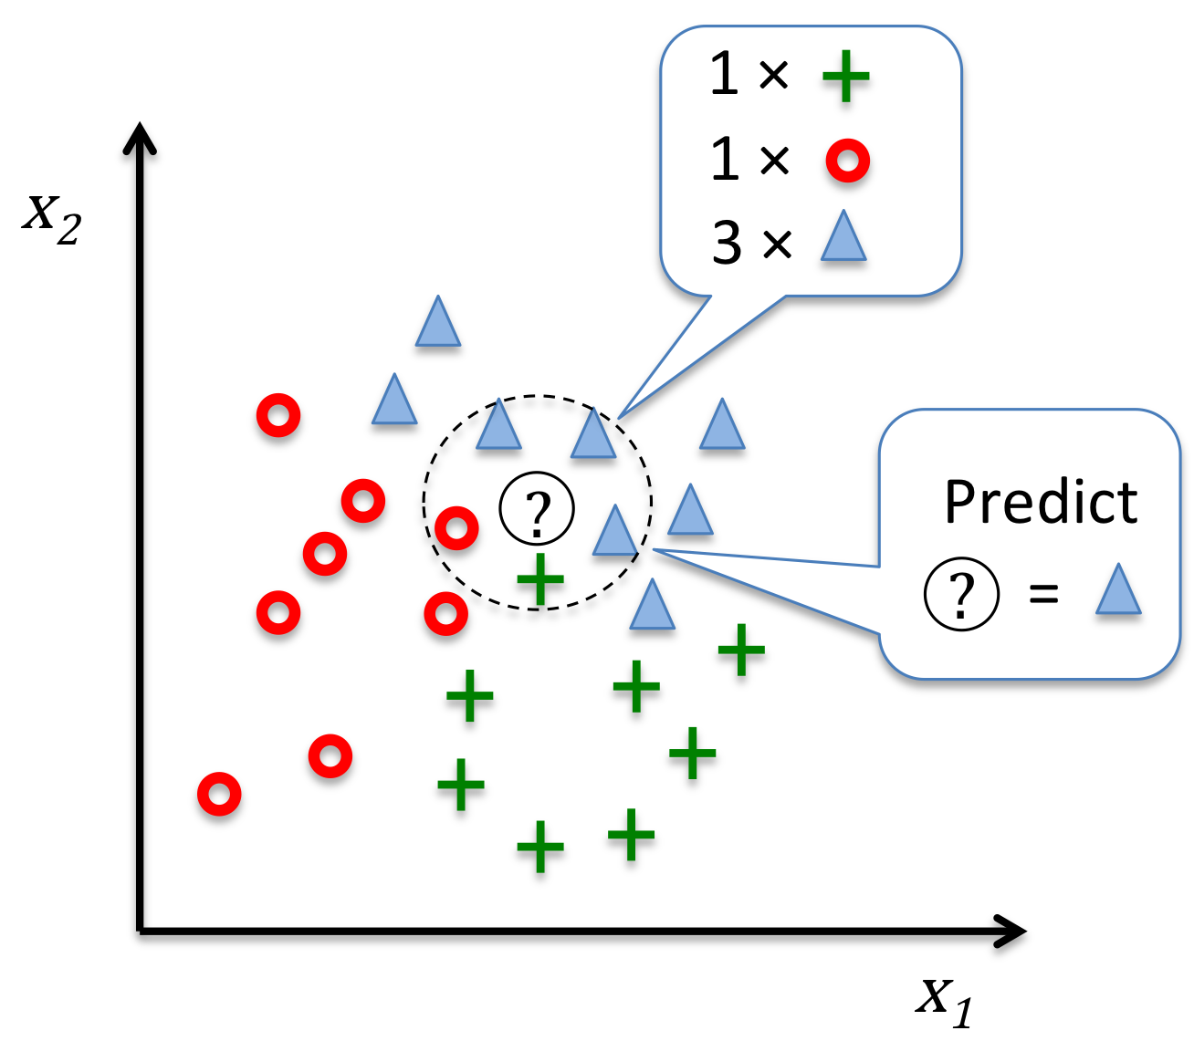
K-Nearest Neighbor
KNN is probably the simplest algorithm:
Choose a number of neighbors k and a distance measure
Find the k nearest neighbors from the sample to classify using the distance measure
Do a vote (majority, weighted majority)
Notes:
Dire qu’il existe plusieurs versions, mais toujours très simple

Slide 5
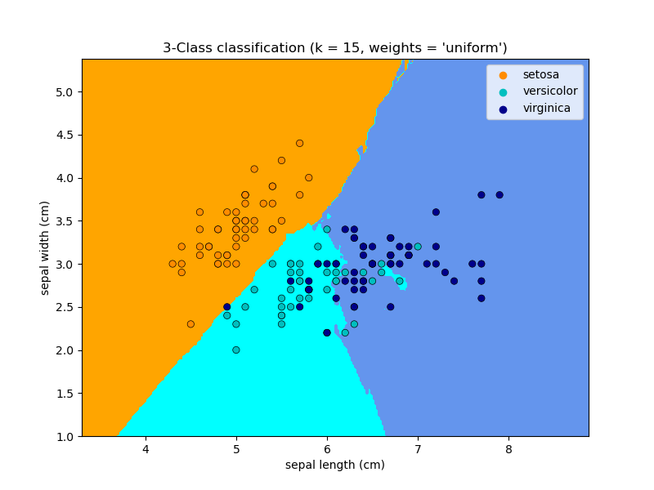
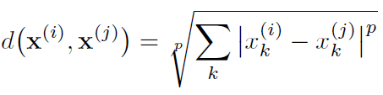
KNN
We generally use a Minkowski distance
Problem: we need to keep all training samples!
Memory become a bottleneck
Since it use a distance, doesn’t work well in high dimensional data
from sklearn.neighbors import KNeighborsClassifier
knn = KNeighborsClassifier(n_neighbors=5, p=2, metric='minkowski')
knn.fit(X_train_std, y_train)
Notes:
P=2→Euclidienne!

Slide 6
KNN in Scikit-Learn
There are two versions in Scikit-Learn, the classic KNN and RadiusKNN
In radius KNN, we specify a radius rather than a k, so neighbors are variable according to the density
In both case we can specify weights as distance or user specific function
To enable fast query, Scikit propose to use a Ball Tree structure
Binary tree where each node defines a D-dimensional hypersphere with only a subset of the samples
It is constructed automatically by recursively splitting samples with a hyperplane that divides the points into two groups of roughly equal size
Continues recursively, creating a tree structure with tighter and tighter balls
Notes:
Tell them the data structure is the key here, brute force is very inefficient

Slide 7

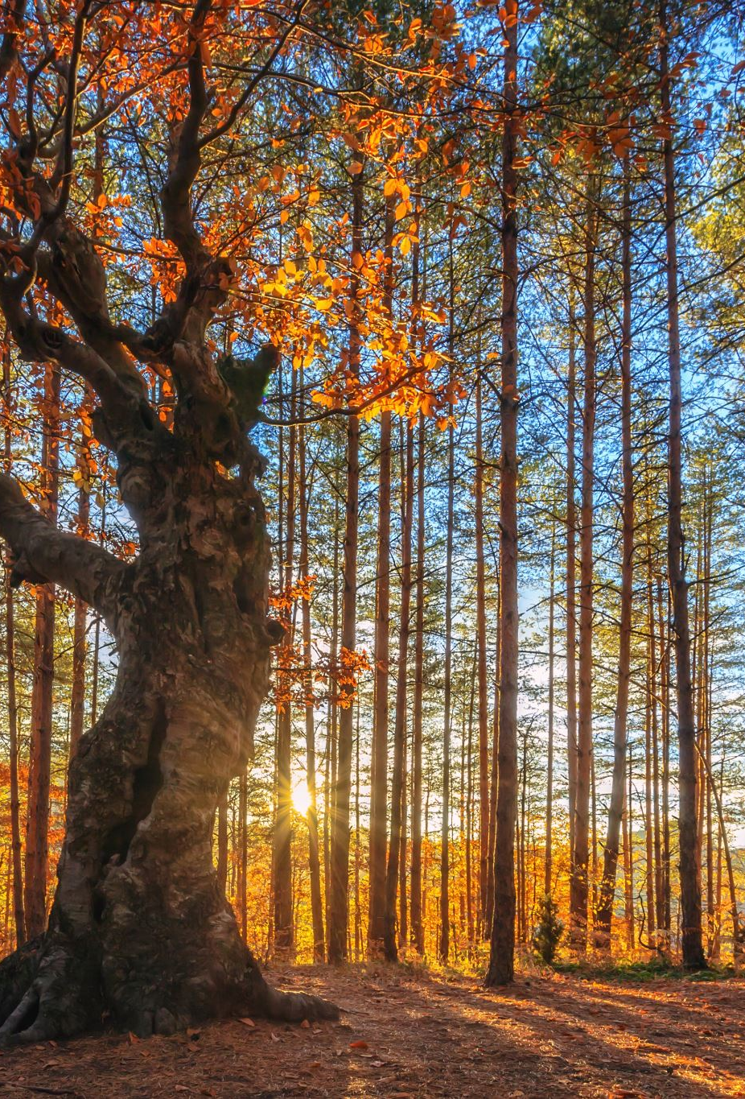

Decision Trees
A decision tree uses the attributes of the dataset to learn a series of questions to infer the classes
We start from a root and split the data on the attribute that yields the greatest Information Gain
We repeat until all leaves are pure (represent a single class)
Beware of overfitting! In practice, we want to limit this process

Slide 8
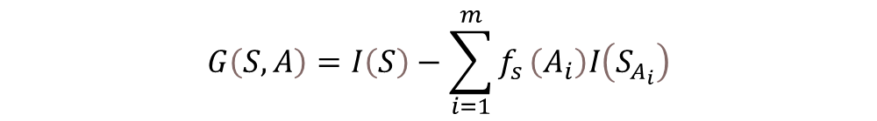
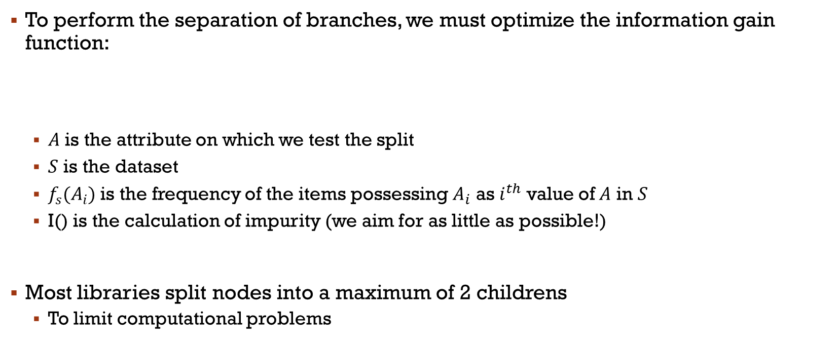
Maximize information Gain
To perform the separation of branches, we must optimize the information gain function:
$A$ is the attribute on which we test the split
$S$ is the dataset
$f_{s}(A_{i})$ is the frequency of the items possessing $A_{i}$ as $i^{th}$ value of $A$ in $S$
I() is the calculation of impurity (we aim for as little as possible!)
Most libraries split nodes into a maximum of 2 childrens
To limit computational problems
$$G\left(S,A\right)=I\left(S\right)−\sum_{i=1}^{m}{f_{s}}\left(A_{i}\right)I\left(S_{A_{i}}\right)$$

Slide 9
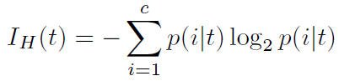
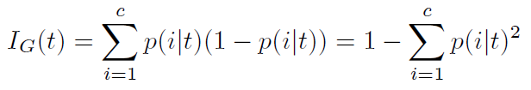
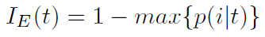
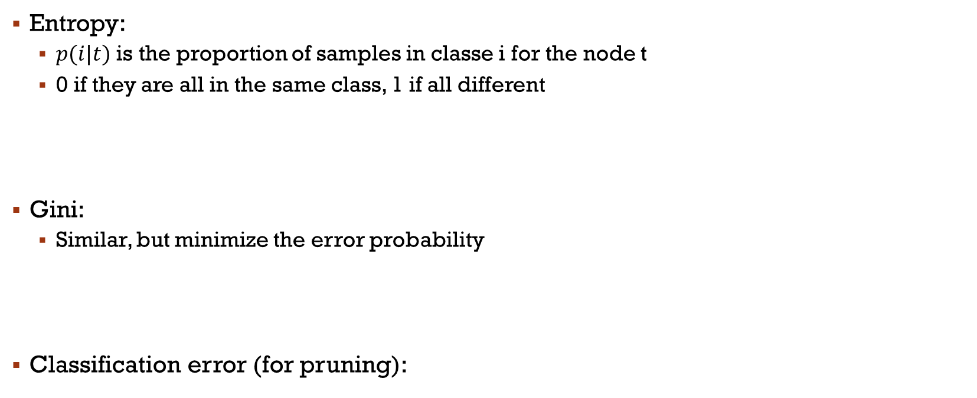
Impurity
Entropy:
$p(i|t)$ is the proportion of samples in classe i for the node t
0 if they are all in the same class, 1 if all different
Gini:
Similar, but minimize the error probability
Classification error (for pruning):
Notes:
Class error: pas génial pour construction, mais bien pour prunning

Slide 10
Iterative Dichotomiser 3
Recursive algorithm

Slide 11
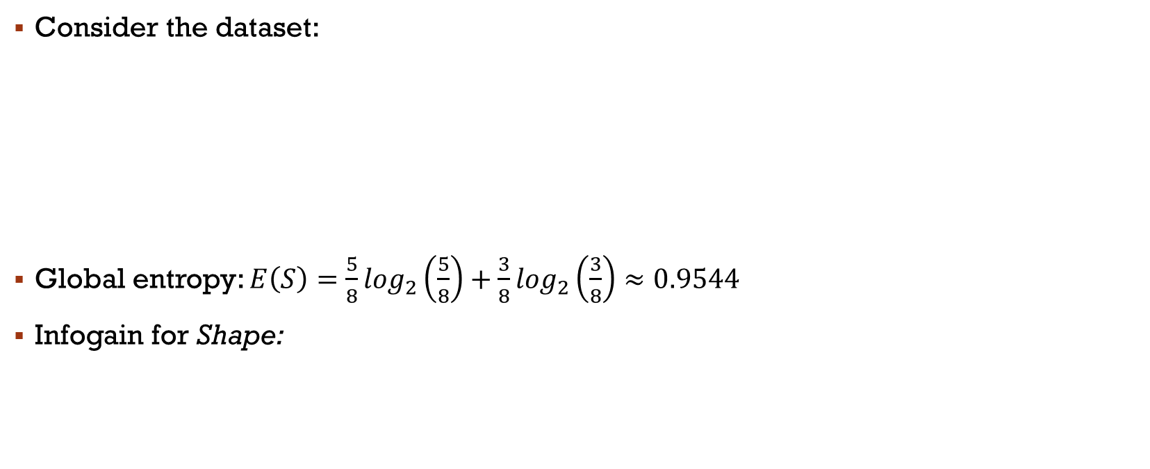
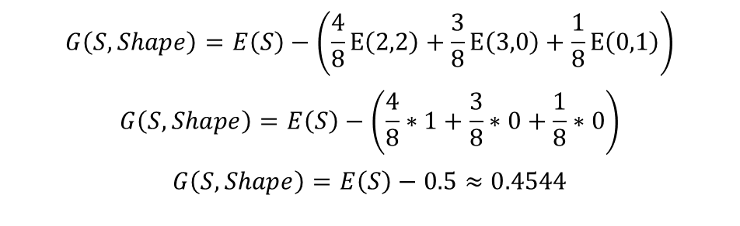
Example using ID3
Consider the dataset:
Global entropy: $E\left(S\right)=\frac{5}{8}\log_{2}\left(\frac{5}{8}\right)+\frac{3}{8}\log_{2}\left(\frac{3}{8}\right)≈0.9544$
Infogain for Shape:
$$G\left(S,Shape\right)=E\left(S\right)−\left(\frac{4}{8}E\left(2,2\right)+\frac{3}{8}E\left(3,0\right)+\frac{1}{8}E\left(0,1\right)\right)$$
$$G\left(S,Shape\right)=E\left(S\right)−\left(\frac{4}{8}∗1+\frac{3}{8}∗0+\frac{1}{8}∗0\right)$$
$$G\left(S,Shape\right)=E\left(S\right)−0.5≈0.4544$$

Slide 12
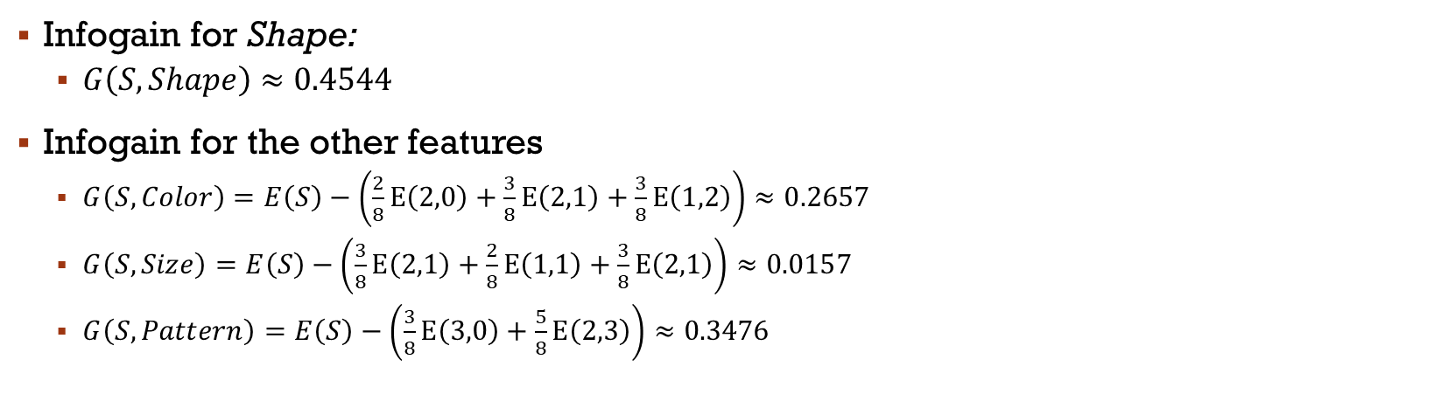
Example ID3
Infogain for Shape:
$G\left(S,Shape\right)≈0.4544$
Infogain for the other features
$G\left(S,Color\right)=E\left(S\right)−\left(\frac{2}{8}E\left(2,0\right)+\frac{3}{8}E\left(2,1\right)+\frac{3}{8}E\left(1,2\right)\right)≈0.2657$
$G\left(S,Size\right)=E\left(S\right)−\left(\frac{3}{8}E\left(2,1\right)+\frac{2}{8}E\left(1,1\right)+\frac{3}{8}E\left(2,1\right)\right)≈0.0157$
$G\left(S,Pattern\right)=E\left(S\right)−\left(\frac{3}{8}E\left(3,0\right)+\frac{5}{8}E\left(2,3\right)\right)≈0.3476$

Slide 13
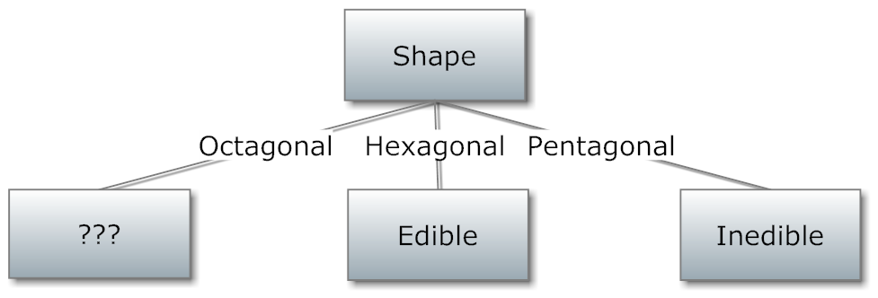
Example ID3
So, we split on Shape since it provides the bigger information gain!
We’re not done, but we’ll use only a subset of the data for the next split

Slide 14
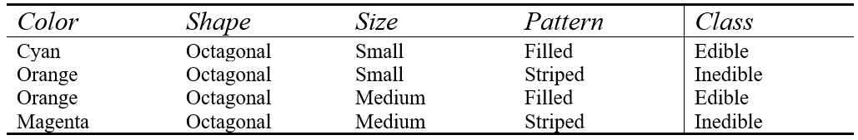
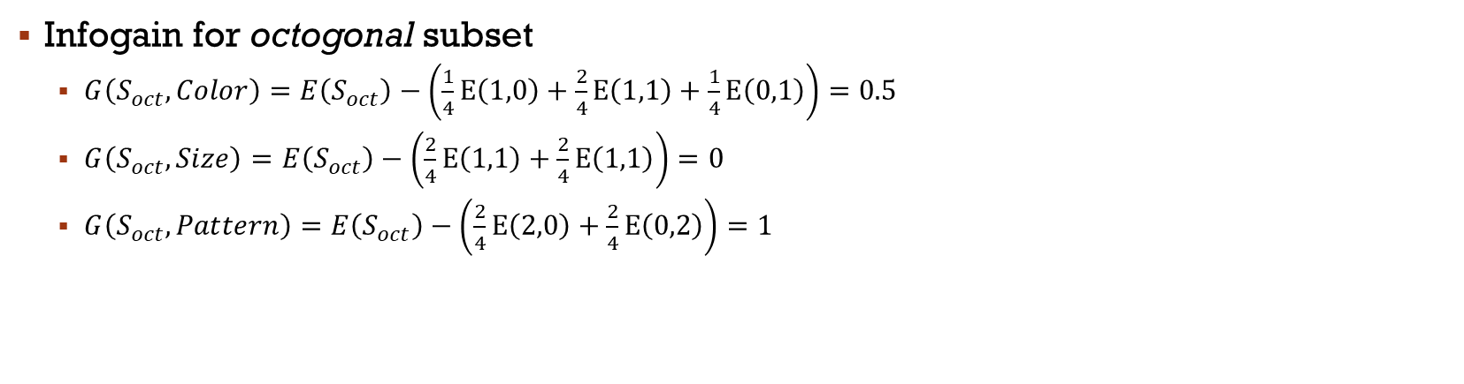
Example ID3
Infogain for octogonal subset
$G\left(S_{oct},Color\right)=E\left(S_{oct}\right)−\left(\frac{1}{4}E\left(1,0\right)+\frac{2}{4}E\left(1,1\right)+\frac{1}{4}E\left(0,1\right)\right)=0.5$
$G\left(S_{oct},Size\right)=E\left(S_{oct}\right)−\left(\frac{2}{4}E\left(1,1\right)+\frac{2}{4}E\left(1,1\right)\right)=0$
$G\left(S_{oct},Pattern\right)=E\left(S_{oct}\right)−\left(\frac{2}{4}E\left(2,0\right)+\frac{2}{4}E\left(0,2\right)\right)=1$

Slide 15
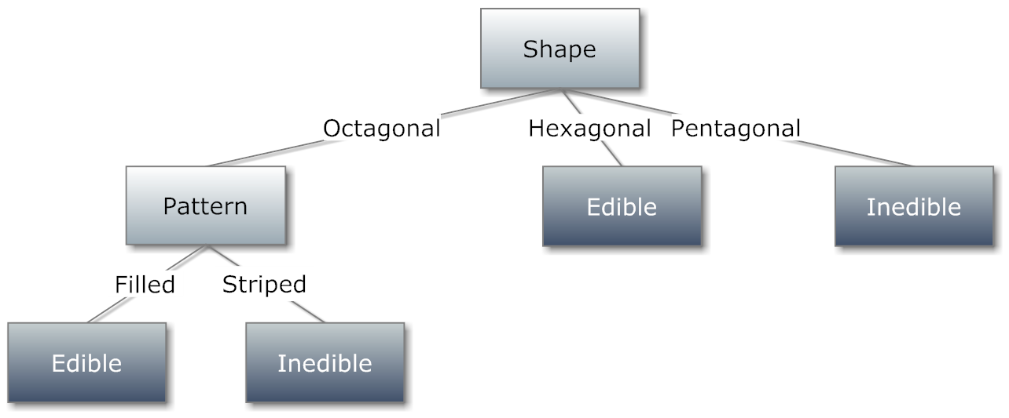
Exemple ID3
All leaves are pure now
The process is over, and the final model is:
Try to classify these unseen instances
[Yellow, Octogonal, Medium, Striped]
[Cyan, Octogonal, Medium, Dotted]
Notes:
What to do? Here is impossible… but usually, our conditions ar more generic

Slide 16
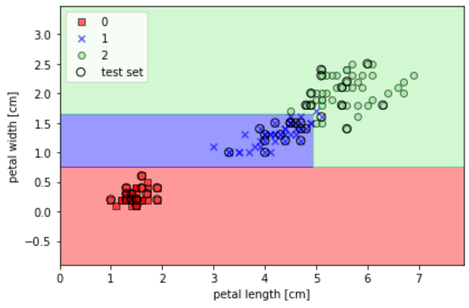
With Scikit Learn
from sklearn.tree import DecisionTreeClassifier
tree = DecisionTreeClassifier(criterion='entropy', max_depth=3, random_state=0) tree.fit(X_train, y_train)
X_combined = np.vstack((X_train, X_test))
y_combined = np.hstack((y_train, y_test))
plot_decision_regions(X_combined, y_combined, classifier=tree, test_idx=(105, 150))
plt.xlabel('petal length [cm]')
plt.ylabel('petal width [cm]')
plt.legend(loc='upper left')
plt.tight_layout()
plt.show()
Still with our Iris dataset
-Max depth
-Prunning :
Many methods to reduce the final decision tree
For instance, we constraint to a minimum of N samples per leaf or the leaf is eliminated
Notes:
Prunning: min samples per leaf
Ou max depth

Slide 17
Decision trees
The biggest advantage of decision trees is the explainability and transparency of the models (XAI).
However, they suffer greatly from class imbalance.
The main algorithms are:
Iterative Dichotomiser (ID3)
Classification and Regression Trees (CART) ← Gini
C4.5 ← Entropy
Very Fast Decision Trees (VFDT) ← Online/incremental
Chi-square Automatic Interaction Detector (CHAID) ← CART but split 2+
Multivariate Adaptive Regression Splines (MARS) ← Non linear regression
Extremely Fast Decision Tree (EFDT) ← VFDT ++

Slide 18

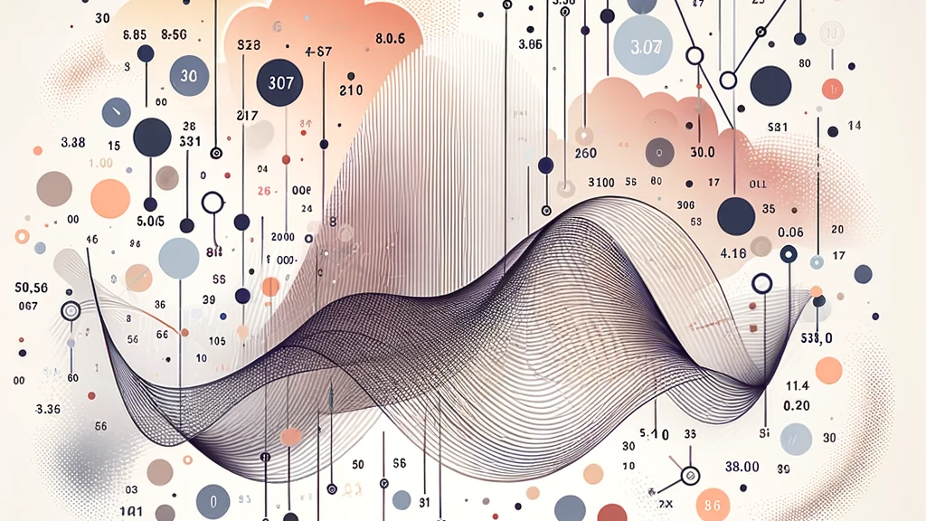
Probabilictic models?
Probabilistic machine learning models are a class of models that incorporate probability theory to make predictions and inferences
Naive Bayes: A simple probabilistic classifier based on applying Bayes' theorem with strong (naive) independence assumptions between the features
Gaussian Processes: A non-parametric model that defines a prior over functions, which can be updated to a posterior over functions once data is observed
Hidden Markov Models (HMMs): Used for temporal data, where the observed data is modeled as a series of outputs generated by a sequence of internal states
Probabilistic Graphical Models (PGMs): Such as Bayesian networks and Markov random fields, which represent the dependencies between variables using a graph structure
They are out of our scope, but we’ll quickly check Naive Bayes Classifier to give an intuition

Slide 19
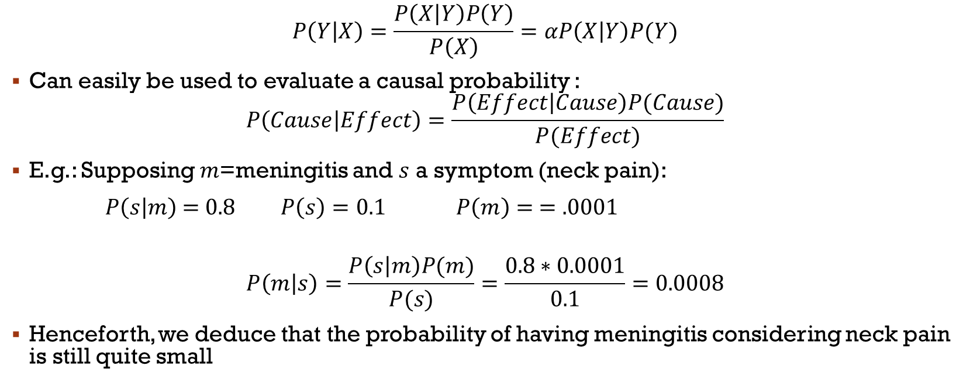
Bayes Rule
$$P\left(Y | X\right)=\frac{P\left(X | Y\right)P\left(Y\right)}{P\left(X\right)}=αP\left(X | Y\right)P(Y)$$
Can easily be used to evaluate a causal probability :
$$P\left(Cause | Effect\right)=\frac{P\left(Effect | Cause\right)P(Cause)}{P(Effect)}$$
E.g.: Supposing $m$=meningitis and $s$ a symptom (neck pain):
$P\left(s | m\right)$ = 0.8 $P\left(s\right)=0.1$ $P\left(m\right)= =.0001$
$$P\left(m | s\right)=\frac{P\left(s | m\right)P(m)}{P(s)}=\frac{0.8∗0.0001}{0.1}=0.0008$$
Henceforth, we deduce that the probability of having meningitis considering neck pain is still quite small

Slide 20
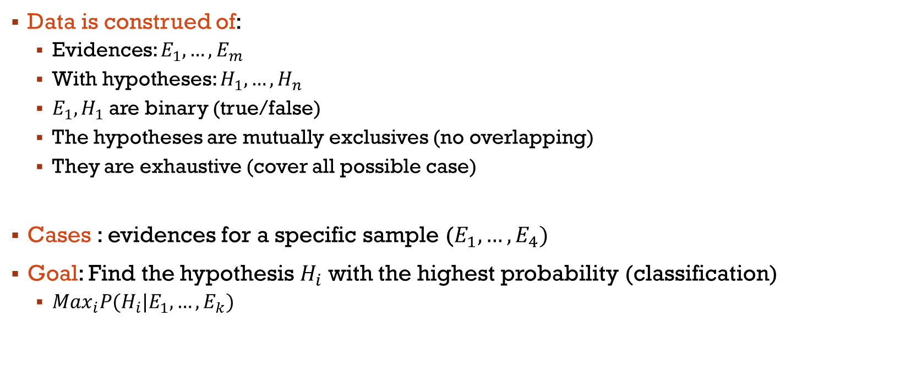
Naive Bayes Classifier
Data is construed of:
Evidences: $E_{1},…,E_{m}$
With hypotheses: $H_{1}, …,H_{n}$
$E_{1},H_{1}$ are binary (true/false)
The hypotheses are mutually exclusives (no overlapping)
They are exhaustive (cover all possible case)
Cases : evidences for a specific sample ($E_{1},…, E_{4})$
Goal: Find the hypothesis $H_{i}$ with the highest probability (classification)
${Max}_{i}P(H_{i}|E_{1},…, E_{k})$

Slide 21
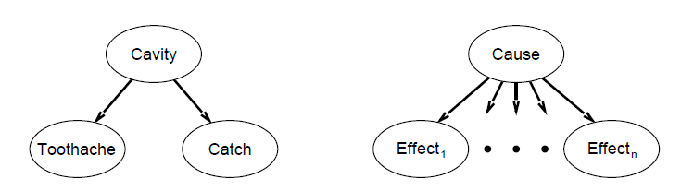
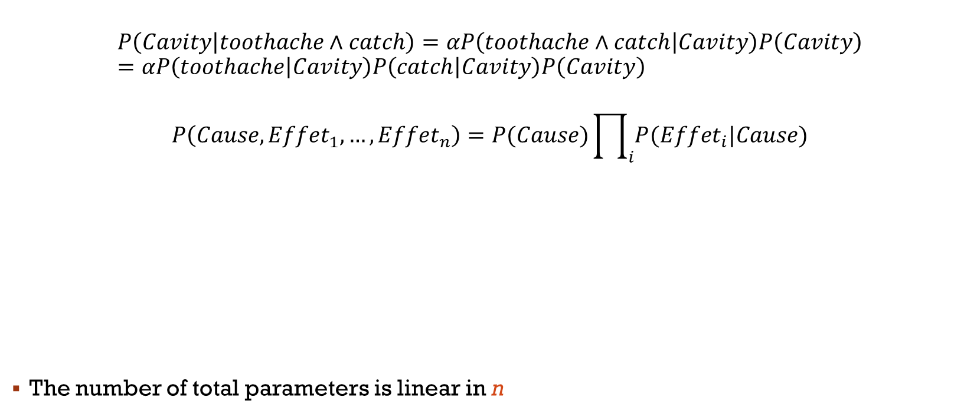
Naive Bayes Classifier
$$P\left(Cavity | toothache∧catch\right)=αP\left(toothache∧catch | Cavity\right)P\left(Cavity\right)=αP\left(toothache | Cavity\right)P\left(catch | Cavity\right)P\left(Cavity\right)$$
$$P\left(Cause, {Effet}_{1},…,{Effet}_{n}\right)=P(Cause)\prod_{i}{P({Effet}_{i}|Cause)}$$
The number of total parameters is linear in n

Slide 22
Conclusion
We won’t go into details regarding the training of Naive Bayes Classifiers considering this is out of our scope
However, you should know that learning in probabilistic models typically involves estimating the parameters of the model that are most consistent with the observed data
This can be done through maximum likelihood estimation or Bayesian estimation
Probabilistic models can handle various types of data and tasks, from classification and regression to clustering and density estimation
So we’ll talk about them again
They are robust to overfitting, particularly in their Bayesian form, because they average over many different possible parameter values when making predictions

Slide 23
Main References
Russell S., Norvig P., Artificial Intelligence: A Modern Approach. Prentice-Hall, Englewood Cliffs, 2021.
Aggarwal, C. C., Neural networks and deep learning. Springer, 2023.
Goodfellow I., Bengio Y., Deep Learning. The MIT Press, 2016.
Raschka S., Python Machine Learning, Packt Publishing, 2015.
Sutton R.S., Barto A.G., Reinforcement Learning: An Introduction, A Bradford Book, 2021.
Witten I.H., Frank E., Hall M.A., Pal C. Data Mining: Practical Machine Learning Tools and Techniques, Morgan Kaufmann, 2016.

